Slide 1
COCONUT DEHUSKING MACHINE
A NON CONVENTIONAL ONE…….

Slide 2
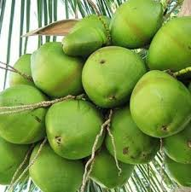
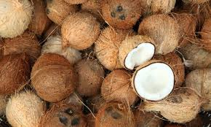
Dehusking:

Slide 3
Components used
Motor
Rollers made of CI
Galvanised Iron Sheet
Pulley
Gear

Slide 4
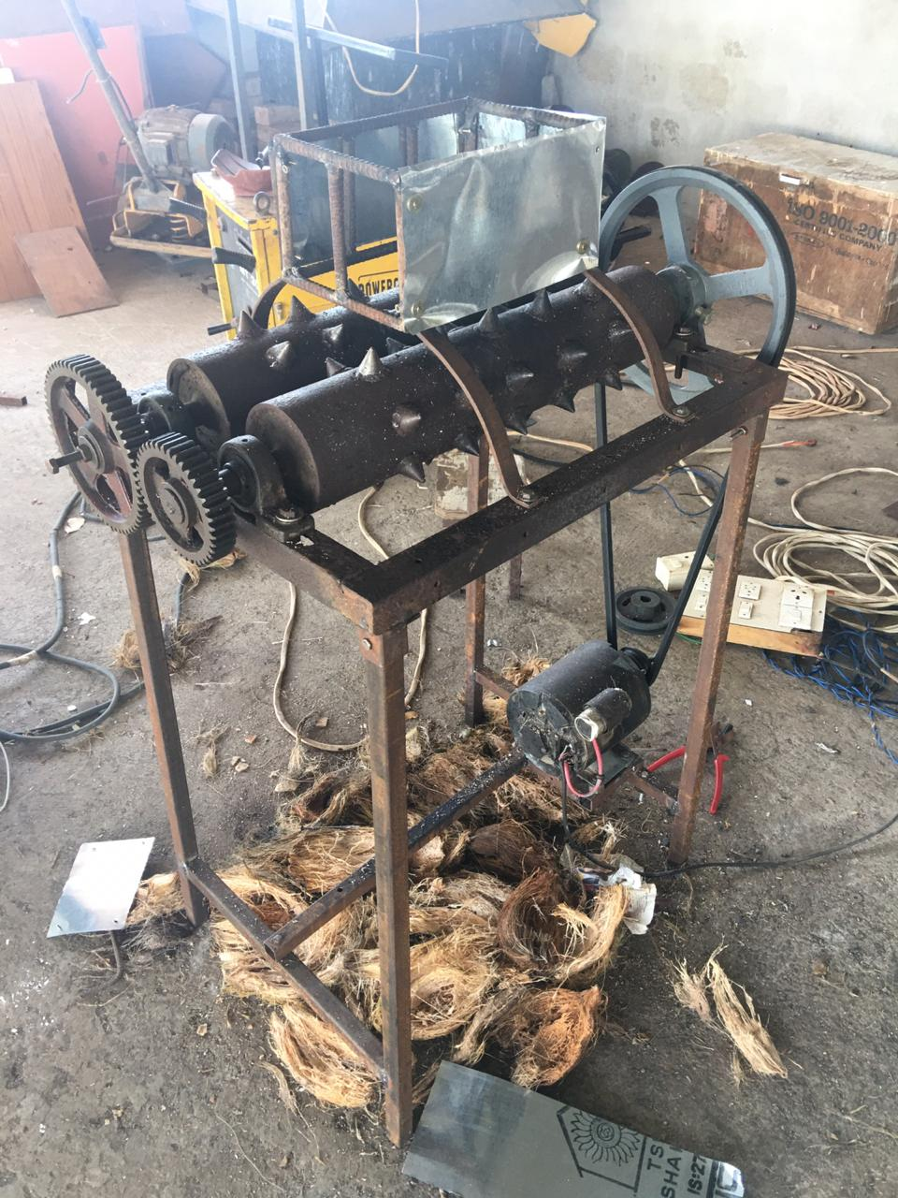

Slide 5
IMPORTANCE :
Reduces the man power
For increasing the safety measures in dehusking of coconut
This dehusking rate of this machine is 10sec per each coconut, which is 50%faster than a skilled labour

